Slide 1

DALEBRO Sourcing Distribution & Consulting
www.dalebro.com

Slide 2
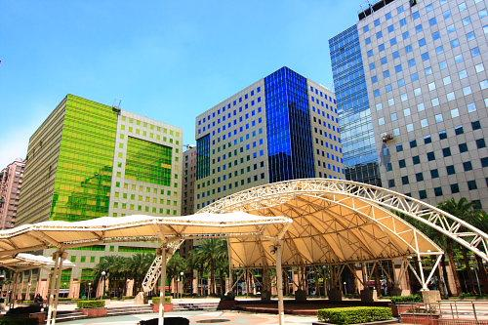

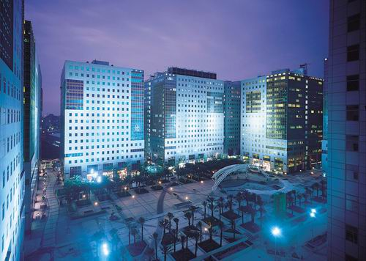
COMPANY PROFILE
About us
DALEBRO WORLDWIDE LIMITED is a Taiwanese company specialized in sourcing services, distribution of products from different industries and consulting services for the Latin American market. We focus particularly on this area due to the huge potential and existing growth. With more than 10 years of experience and with a trained professional team, we also provide consulting services for the development of new business or establishment of industrial factories.
Vision & mission
Our vision is to become the customer’s eyes and hands in Asia, minimizing their risks and maximizing their profits. We seek to consolidate as a leader par excellence, always providing value-added services at each stage of work.
Photo: Business Complex where Dalebro office in Taipei is located.
OUR OFFICES
Since we first started operations in 2003, we have strategically opened offices in Asia and Latin America:
TAIPEI OFFICE HEADQUARTER
MIAMI OFFICE
GUANGZHOU OFFICE
The headquarter established in Taipei, has a consultant team, financial team and logistic team.
Staying closer to our customers to provide an immediate response.
For managing the relationship with suppliers and quality control of products.
www.dalebro.com

Slide 3
WHY CHOOSE DALEBRO
RECURSOS
TANGIBLES
BENEFICIOS
INTANGIBLES
Oficinas en diferentes continentes
Alta movilidad y respuesta inmediata
BENEFICIOS
Manejo del idioma español, chino e inglés
Sin barreras de comunicación
- Alto Rendimiento
- Incremento de su margen económico
- Un paso adelante de la competencia
Contamos con recursos humanos, materiales y conocimientos
Aportamos servicios de valor agregado
- Reducción de Costos
- Disminución de operaciones
- Disminución de tiempo y demoras
Profesionales con experiencia en la industria
Ejecución eficaz de estrategias y procedimientos
RIESGOS
www.dalebro.com

Slide 4


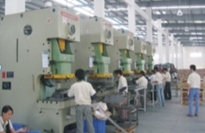
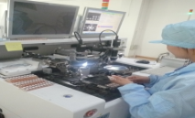
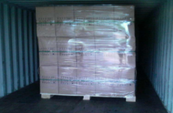

VALUE CHAIN
ANALISIS DE LA INDUSTRIA
Estudio del mercado, búsqueda y verificación del fabricante y productos.
Our value
In each link of the chain of work you can appreciate Dalebro value-added services that we offer to ours customers. We coordinate and supervise in detail all process and operations in the supply chain:
PLANIFICACION
Planificación y definición de características, parámetros de calidad, precios y términos de compra.
PRODUCCION
Tercerización de la producción, verificación del BOM y plazos de entrega.
CONTROL DE CALIDAD
Supervisión del proceso de producción (SOP), determinación de los criterios de control y nivel de calidad.
LOGISTICA
Coordinación del transporte logístico y preparación de documentación requerida.
POST-VENTA
.
Seguimiento en caso de RMA y asistencia en consultas del cliente.
www.dalebro.com

Slide 5
SERVICE - SOURCING
Dalebro – LEADER in SOURCING SERVICES
China has become the manufacturing center of the world, with thousands of factories producing a wide variety of consumer products. Dalebro gives support to companies for handling international procurement especially in Asia. As your sourcing agent we not only take care of finding the product with the desired quality but also the verification of reliable manufacturers in order to establish a long term business relationship between manufacturer and customer.
CIRCULO BENEFICIOSO
Control de producción
Inspección y Control de Calidad
Negociaciones de precios y términos de compra
One Stop Shop
Servicios logísticos
DALEBRO
Servicio de búsqueda de fábricas y productos
Otros servicios de valor agregado
CLIENTE
We reduce operations by being a “ONE STOP SHOP” offering several services in one place.
One Stop Shop
Your office in Asia
We are your contact point in Asia, minimizing your infrastructure cost and personnel.
Team work
Customer is responsible for sales in local market, Dalebro is responsible for the operational management in Asia checking that customer’s orders meets their expectations.
www.dalebro.com
www.dalebro.com
www.dalebro.com

Slide 6
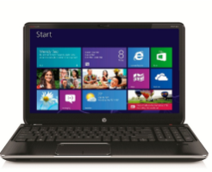
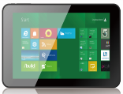

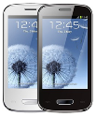




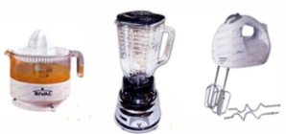




SERVICE – DISTRIBUTION
Dalebro – Excellent distributor
We are leading distributor of products manufactured in China for Latin America. Over the years we have acquired a portfolio of brands and products with trusted vendors offering good quality and competitive costs. We have the knowledge to handle the purchase process, supply chain as well as local export regulations making the job easier for our customers.
We have a porfolio of validated products where the most outstanding are:
Productos de Electrónica de Consumo
Ofrecemos al cliente productos con marca propia y en todo tipo de formatos:
Productos de Energía Limpia y Renovable
OEM & ODM:
- Marca del Cliente
- Marca Genéricas
Línea Blanca y Hogar
Productos en Formatos:
- CBU: Complete Built Unit
- SKD: Semi-Knocked Down
- CKD: Complete-Knocked Down
Otros
www.dalebro.com

Slide 7
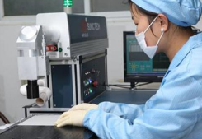
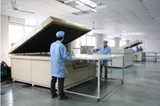
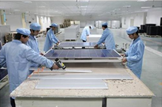
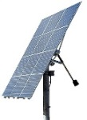
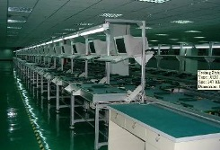
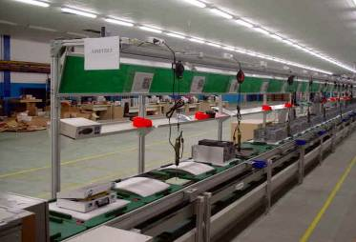
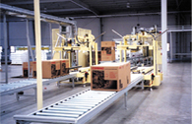

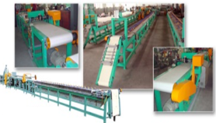
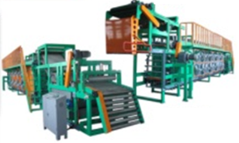
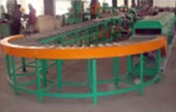
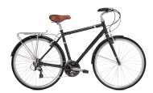
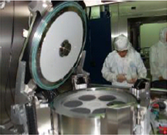

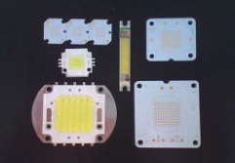

SERVICE – CONSULTING
Dalebro – turnkey solutions specialist
"Turnkey Solutions" - are engineering projects that can be designed, produced and adjusted to fit customers requirements so it can be used immediately after the delivery. Through the years, Dalebro has accumulated the knowledge, experience and resources in different areas to provide consulting services to our customers in the implementation of new technologies and production methods in their countries. We assist our customers with the transfer of knowledge, the "know-how" to enable production in the shortest time possible and more efficiently.
Successful cases implemented by Dalebro:
Production line for solar panels in Argentina
=
Assembly line for PC & notebooks in Mexico
=
Production line for bicycle inner tube in Argentina
=
Production line for LED lights in Brazil
=
www.dalebro.com

Slide 8
CONTACT US
Dalebro – Taiwan (Headquarter)
3F., No. 16, Jian 8th Rd., Zhonghe District, 235, New Taipei City, Taiwan Tel: +886-2-82263818 Fax: +886-2-82263819 Email: info@dalebro.com
Dalebro – China
No. 2, 7FL, Zhukeng Village, Panyu District, Guangzhou, Postcode: 511400, Guangdong, China Tel: +86-20-22871559 Fax: +86-20-22871663 Email: info@dalebro.com
Dalebro – Latin America
9555 SW 181st Terrace, Miami, FL33157, USA
Tel: +1-786-4448632
Email: info@dalebro.com
www.dalebro.com

